Slide 1


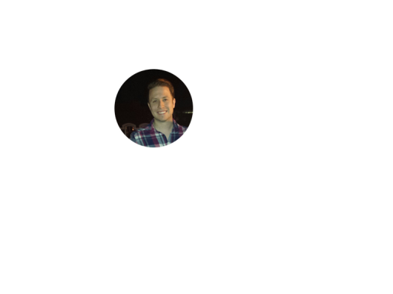


Home Irrigation Control System (HICS)
Team Status Report
January 30, 2015
Belachew
Haile-Mariam
Gautam
Adhikari
Jeremiah
O’Connor
Tung
Vo
Notes:
This presentation demonstrates the new capabilities of PowerPoint and it is best viewed in Slide Show. These slides are designed to give you great ideas for the presentations you’ll create in PowerPoint 2010!
For more sample templates, click the File tab, and then on the New tab, click Sample Templates.

Slide 2

Progress From Holiday Break

Slide 3
Progress Over the Break
Web Application
Built the backend and framework for the web application
Created services for the CRUD functionality of the current domains
Implemented the login feature with session state creation

Slide 4
Progress Over the Break
Central Control Unit
Developed code to allow communication between central control unit (Raspberry Pi) and hardware input/output layers(Arduino)

Slide 5
Progress Over the Break
Hardware Input/output
Experimented with reading soil moisture sensor data into an Arduino
Experimented with reading temperature sensor data into an Arduino

Slide 6
Progress Over the Break
Additional Work
Updated ADS to incorporate feedback from review
Established meeting times to fit our schedules for the Spring 2015 semester
Met with our sponsor to review our ADS baseline and outline our plans for Senior Design II

Slide 7
Key Changes from ADS Review

Slide 8
Key Changes
Resolved the naming ambiguity of our “Client-Server” architecture design
Added and updated components of the data flow diagram
Changed database subsystem and added an external database interface
Expanded our analysis of the Producer-Consumer Matrix

Slide 9
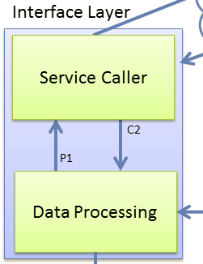
Key Changes
Resolved Client-Server Ambiguity
Renamed all references of “Client Layer” to “Interface Layer”
Changed all diagrams, tables, and figures to represent this renaming

Slide 10
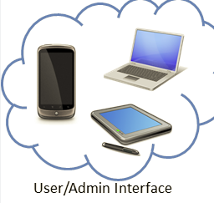
Key Changes
Updated Data Flow Diagram
Encapsulated user/admin devices in a cloud to represent that they are web based

Slide 11
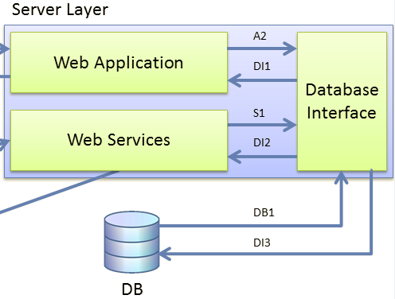
Key Changes
Changed DB Subsystem & External DB Addition
Changed the “Database” subsystem name to “Database Interface”
Added an external database outside of our system that interacts with the Database Interface

Slide 12
Key Changes
Producer-Consumer Relationships Analysis
Added an in depth analysis of the relationships between the producer and consumer
Detailed the overall balance of data flow between subsystems

Slide 13
The Future…
What is next?
Do research on how the proper way that our irrigation valves should receive power for the demonstration
Finalize parts list and start submitting purchase orders by next class period
Begin work on our DDS draft document
Begin building our demo project enclosure
Set a time/date for a team building activity

Slide 14
Any Questions?
?

